Slide 1

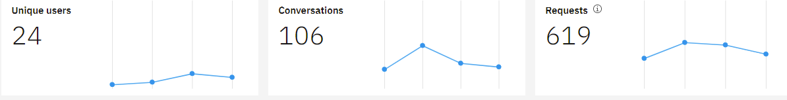
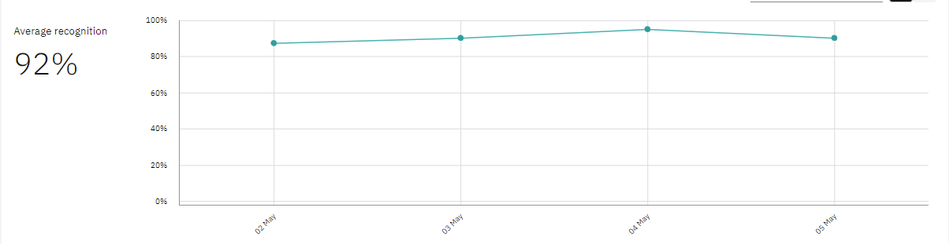
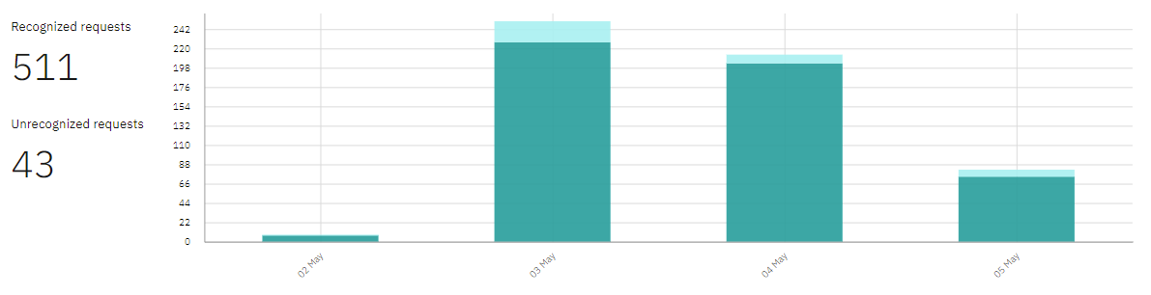
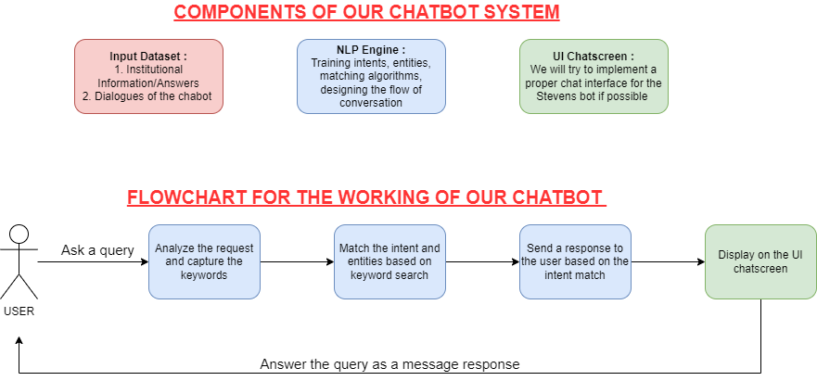
FAQ Chatbot for Office of Graduate Admissions Rajiv Mahajan, Shreeya Kokate, Sai Srivedh Chagantipati
Business Intelligence & Analytics
Business Problem
We see a lot of students from the school and especially incoming students will have many doubts like regarding their application status, Fee waiver, about the unofficial test scores, transcripts, etc... Addressing each and every student all the time individually can be a difficult task sometimes. That is where an Artificial Intelligence Chatbot comes into picture. It is designed in such a way that it will be capable enough to answer all general questions, which will be of great help for the employees. Our aim is to build and deploy one for the Office of Graduate Admissions, Stevens Institute of Technology.
Data, Scope, Privacy Issue
We have 1 sources of data which is an External source. External Source would be the University website where we can find generic QnA sets. We have scrapped the data from Stevens Graduate Admissions using an automated bot called Axiom.
Scope: focusing on creating a chatbot to be used by students to get their queries responded to easily from the college website. The Stevens Inquiry Chatbot (SIC) has the capacity to make friendly conversations; respond to the departments like Admissions, PhD/Graduate Orientation, Open Houses, Academic department, and ISSS. To build the chatbot, IBM Watson Assistant, Topic Modeling, and Knowledge base services will be utilized.
No, currently there won’t be any data privacy issues. For this course project we only aim to implement Stage1 and Stage2 is just the future scope of our problem statement.
Business Question
1. Will the advanced technology assist the user in smooth understanding of the admission process?
2. Will we be able to achieve accuracy in addressing the exact concerns of the student without any involvement of the respective officials?
3. Till what level can we reduce the repetitive workload of the organization through automation?
Results
The below statistics, tells us we have a total of 87 conversations were made till now with the chatbot from 12 different users and they had 429 requests in total. From the graph below, we have achieved 92% of accuracy.
Approach
Our work is divided in 3 components, namely, preparing the input dataset, Natural Language Processing (NLP) Engine and the user interface. We have used IBM Watson Assistant for this project.
Intents: They are purposes or goals that are expressed in a customer's input, such as answering a question or processing a bill payment. By recognizing the intent expressed in a customer's input, the Watson Assistant service can choose the correct dialog flow for responding to it. We have started incorporating our chatbot with a total of 44 intents. We have used existing intents with some customization and created a few of our own as per needed.
Entities: Entities are used for identifying interesting parts of the user's utterance, such as names and dates. Watson Assistant already provides system entities (for date, time, names, etc.), and lets you define entities with synonyms and fuzzy matching, as well as defining pattern-based entities. We have incorporated a few customized entities as per needed for our chatbot.
Dialog: The dialog uses the intents that are identified in the user's input, plus context from the application, to interact with the user and ultimately provide a useful response. The dialog matches intents (what users say they want to do) to responses (what the bot says back). We have built the dialog chat flow by adding nodes, child nodes in a way that the machine understands the user questions and be able to answer accurately.
Conclusion
Through chatbot with IBM Watson Assistant technology we were able to make a smooth understanding process for OGA including academics, isss, waiver requirements, and achieving the main goal in addressing FAQs asked by the applicants who wanted to know about Stevens. On observing the chatbot response the accuracy turned out to be 92% which led applicants in savings their valuable time. With that accuracy it's clear any repetitive work or FAQs asked by the applicants for any department can be automated and addressed by the Stevens chatbot.
Future Work
We can allow user login and thus solve a more detailed query which requires handling sensitive data and access to user data. This would be the phase where we might have data privacy issues which can be solved by using authentication, authorization, end-to-end encryption, etc. techniques.
http://www.stevens.edu/school-business/masters-programs/business-intelligence-analytics

